Slide 1
Print
Versus
Web
Introduction to Graphic Arts Technology

Slide 2
Objective
Objective: Students will describe the difference between print and web documents.
Checking for Understanding:
What will you be able to describe after today’s lesson?
What will you be able to explain after today’s lesson?
Students will describe the difference between print and web documents.
Students will explain what a raster graphic is.
Students will explain what a vector graphic is.
Students will explain what cmyk and rgb are.

Slide 3
Computer Graphics
Objective: Students will describe the difference between print and web documents.
Checking for Understanding:
In your own words describe what computer graphics is.
Computer graphics are graphics created using computers. The term computer graphics includes technologies used to create and manipulate pictorial data.

Slide 4
Products of Computer Graphics
Objective: Students will describe the difference between print and web documents.
Checking for Understanding:
What are some other products you can think of that are created on computers?
Fine Art
Illustrations
Newspapers
Magazines
Logos
Brochures
Movies
Animations
Billboards
Posters
Video Games
Postcards
Websites
Banner Ads
Books
Displays
Merchandising materials
Products
And much more!

Slide 5
Types of Images
Objective: Students will describe the difference between print and web documents.
Checking for Understanding:
What is a raster graphic?
What is a vector graphic?
What is a pixel?
There are two main types of images in computer graphics:
  Raster graphics are composed of pixels. A pixel is the smallest unit of a video display.
  Vector graphics are composed of paths. These paths are created by mathematical relationships that describe the points and the paths that make up the image.

Slide 6

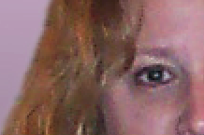
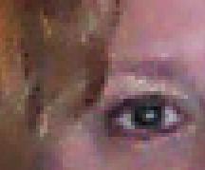
Raster Graphics
Objective: Students will describe the difference between print and web documents.
Checking for Understanding:
What is a raster graphic?
What makes up a raster graphic?
What are raster graphics best used for?
What program would you most likely use to create a raster graphic?
The main program you will work with that creates raster graphics is Adobe Photoshop.
Raster graphics are composed of pixels. A bitmap image (another word for raster graphics) is a grid that is made up of individual pixels. The image is created by how many squares in the grid are filled in and what color they are. Bitmap images are best for photographs and images with subtle shading.

Slide 7
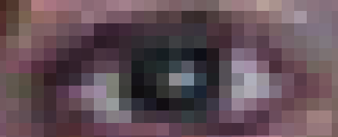
Raster Graphics
Objective: Students will describe the difference between print and web documents.
Checking for Understanding:
What is the biggest problem with raster graphics?
Why is enlarging a raster graphic a problem?
The biggest problem with raster graphics is that you cannot enlarge them any larger than the size they were created at Because the artwork is made of pixels, when you enlarge it the program guesses where to fill in the pixels in the grid. That is why when you enlarge a raster graphic it looks jagged.
The Pixel Close Up

Slide 8
Vector Graphics
Objective: Students will describe the difference between print and web documents.
Checking for Understanding:
What are vector graphics composed of?
What are the best uses for vector graphics?
What is the main benefit of vector graphics?
What program would you use to create vector graphics?
The main program you will use that creates Vector Graphics is Adobe Illustrator.
Vector graphics are composed of paths. These paths are created by mathematical relationships that describe the points and the paths that make up the image.
Vector graphics are best suited for page layout, type, line art, and illustrations. The main benefit of vector graphics is that they can be enlarged to any size and still display exactly as they were drawn.

Slide 9
The Main File Types
Objective: Students will describe the difference between print and web documents.
Checking for Understanding:
What is a native file format?
Why would you use a native file format?
What is a jpeg? Gif? Tiff? EPS? PDF?
What do you think is the most useful file format?
There are several different file types that you can save your work in.
Native File Formats
These formats are meant to save them in the program’s native format for work in the program only. When you want to publish the file you will want to save it as another file type.
  Adobe Illustrator (.ai): This is the standard format to save work files in Adobe Illustrator.
  Photoshop (.psd): This is the standard format to save work files in Adobe Photoshop.
Vector Based Formats
  Encapsulated PostScript (.eps): This is the next best choice for saving vector graphics. The EPS format will maintain the mathematical descriptions of your file. EPS files are supported by most graphics applications. It is best to use EPS files for illustrations because they can be reproduced at any size or resolution and display exactly as they were drawn.
Raster Based Formats
  JPEG (.jpg): Joint Photographic Experts Groups. This format is used for photographic (continuous tone) images. The JPEG format also uses compression for smaller files and faster downloads.
  Graphics Interchange Format (.gif): This format is used mainly for compressing images to smaller size so they can be downloaded faster. This format is mainly used for images on the internet. The GIF format uses a fixed color palette limited to 256 colors or less.
  Tagged-Image File Format (.tiff): This file format is used for bitmap images only. It is supported by almost all graphics programs.
Multipurpose Formats
  Portable Document Format (.pdf): The Adobe Portable Document Format is used for publishing electronic documents. Once a document is saved in this format anyone can open it with the Adobe Acrobat Reader (which can be downloaded for free) without having the program the art was created in and the artwork looks exactly as you created it. This makes it a great format for transferring files.

Slide 10
Graphics for Print
Objective: Students will describe the difference between print and web documents.
Checking for Understanding:
When you have something professionally printed what format would you be asked for?
Why is an EPS better for print?
When you have something professionally printed you’ll probably be asked for an "EPS" or a “PDF” of the file. Ever wonder why you can't just use a JPG, like on your website? What is the difference between an EPS (Encapsulated PostScript) and a JPEG (Joint Photographic Experts Group).
In brief, an EPS is the standard file format used for printing (e.g., business cards, brochures, signage, etc.), while JPG and GIF files are the most common file formats used on the Internet.
Here's why an EPS is better for print:
An EPS file contains vector information, which means its resolution is not determined by pixels. As a result, an EPS can be made as large or small as necessary without compromising print quality or losing design detail. There's a good chance an EPS file will display poorly on your computer screen, but this does not mean it will print badly. Regardless of how it looks on your screen, it is the file you need to produce professional-grade printed materials.

Slide 11
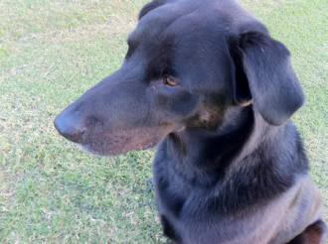


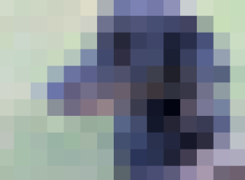
Graphics for Web
Objective: Students will describe the difference between print and web documents.
Checking for Understanding:
What is a jpeg?
What are jpegs best for?
What resolution to computer monitors display at?
Why do we only put images of 72 pixels per inch on the internet?
A jpeg is a compressed image file suitable for use on the Internet (e.g., your website). It contains raster information, which means that its resolution is determined by the size of its pixels. A jpeg can display images consisting of millions of colors. As a result of its powerful compression capabilities, jpegs are good for displaying photos and images with complex color schemes.
Computer monitors only display about 72 dpi (dots per inch or pixels per inch). A high-resolution image displayed on a web page will contain all of the original pixels, but will only display slightly under half of them. For this reason, graphics for the web are generally created at a resolution of 72 dpi to reduce the amount of time and bandwidth wasted to download extraneous information.
300 dpi
150 dpi
72 dpi
10 dpi

Slide 12
Things to Consider When Printing
Objective: Students will describe the difference between print and web documents.
Checking for Understanding:
What dpi should graphics for print be?
What is the file format most printers prefer?
What is the most important thing you should consider when sending a file to print?
When can you get away with a lower resolution file?
Graphics for print generally need to be at least 300 dpi or created in a vector based program so they maintain their integrity of the images even if they are reduced are enlarged.
Encapsulated Postscript (eps) is the format of choice for most printers. Although, many printers or publishers now accept Adobe Portable Document Format (pdf).
The most important thing to bear in mind is that your artwork is at the correct resolution for the image size you are printing. If you artwork is vector based (Adobe Illustrator) you don’t need to worry about resolution. If your image is raster based then your artwork needs to be at least 300 dpi at the size you are commercially printing it.
If you are printing on a digital printer you can get away with a lower resolution.

Slide 13
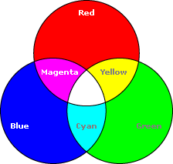
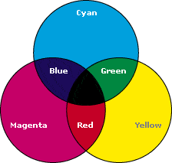
Understanding Color in Graphics
Objective: Students will describe the difference between print and web documents.
Checking for Understanding:
What does RGB stand for?
What does CMYK stand for?
Which model is used for the internet or computer displays?
Which model is used for print?
RGB (Red, Green, Blue)
CMYK (Cyan, Magenta, Yellow, Key)
RGB Color Model: RGB mode is an additive color model. Additive color models use light to display color. This mode is used for computer displays. The light colors result from transmitted light. Red+Green+Blue=White.
CMYK Color Model: CMYK is a subtractive model. Subtractive models use printing inks. Colors perceived in subtractive models are the result of reflected light. This model is used for designs that will be printed. Cyan+Magenta+Yellow=Black. When these designs are printed they use four colors: cyan, magenta, yellow and key(black) ink.

Slide 14
Wrap Up
The two main uses of computer graphics are:
Print Graphics for images that will be printed.
Digital Graphics for images that will be seen on the internet, video games, or on a screen.
Print Graphics
Vector Graphics
Digital Graphics
Raster Graphics
CMYK Color Format
Pixel Based
RGB Color Format
72 dpi
Mathematically based

