Slide 1
Typography
Typogra
Typogra
Typography
Typography

Slide 2
Designers use typography to communicate a client's message to an audience.
They explore the creative possibilities presented by words (typography). It is up to the designer not only to find or create appropriate letterforms but also to establish the best balance between them.
Notes:
Introduce PowerPoint to students and talk to them about why teachers use typography.
CFU: Why do designers use typography?
What are some good examples of typography that you have seen on tv, posters, print, logos, magazines, etc.?
What did you like about those examples?

Slide 3
Typestyles
Fonts are a series of letters, symbols and numbers that are designed to have a common look.
Variations can be created on the base font such as italic and bold.
There are two main types of fonts:
Serif Fonts
Sans Serif Fonts
Notes:
Describe what fonts are to students. Then talk about what the two main font styles are:
CFU:
What are fonts?
What are the two main types of fonts?

Slide 4
Types of Fonts
Serif Fonts
Sans Serif Fonts
Serif fonts have a tear drop form at the edges.
They are easier to read and are often used in body copy to make reading easier and faster.
Don’t have a tear drop form at the edge.
They are often used for headlines where you want to draw the readers attention and slow the reading.
S
S
Notes:
Describe the two types of fonts: Serif and Sans Serif.
CFU:
Describe a Serif font.
Describe a Sans Serif font.
What is the difference between a Serif and Sans Serif font?
Tip: If you have a white board, chalk board or smart board choose random volunteers to come up and draw an example of a Serif or Sans Serif font.

Slide 5
Specialized Fonts
Script – designed to look like handwriting
Script
Text-designed to look like old fashioned calligraphy
Text
Display Types – larger and bolder and designed to be used in headlines and posters.
Display
Notes:
Describe to students the different type of specialized fonts.
CFU:
Describe what a script font is. Give an example of where you would see this type of font.
Describe what a text font is. Give an example of where you would see this type of font.
Describe what a display font is. Give an example of where you would see this type of font.

Slide 6
Relationships of Type
When a graphic designer uses type they often use more than one font in a project. Those relationships can be:
Concordant – uses only one type
Conflicting – two fonts that are very similar but not the same.
Contrasting – two types that are extremely different
Notes:
Describe to students the different types of type relationships.
CFU:
What is a concordant type relationship?
What is a conflicting type relationship?
What is a contrasting type relationship?
What is the best type of relationship? Why?

Slide 7
Type Size and Weight
Type Size – measured from top of ascender to bottom of descender.
Baseline- where the letters sit
Descenders – letters that drop below the baseline
X-height – the height of the lowercase letters
Ascenders – letters that go above x-height
Font Size
Ascender
Typed
X-height
Baseline
Descender
Notes:
Describe to students the different types of type relationships.
CFU:
What is the baseline?
What is a descender?
What is a X-height?
What is an ascender?
How is type measured?

Slide 8
Kerning and Tracking
Kerning
Tracking
Kerning – the space between two pairs of letter.
Julie
J ulie
J ulie
Tracking –the adjustment of spacing of large sections of type.
Julie
J u l i e
J u l i e
Notes:
Describe to students what is kerning and tracking.
CFU:
What is kerning?
What is tracking?
What is the difference between kerning and tracking?

Slide 9
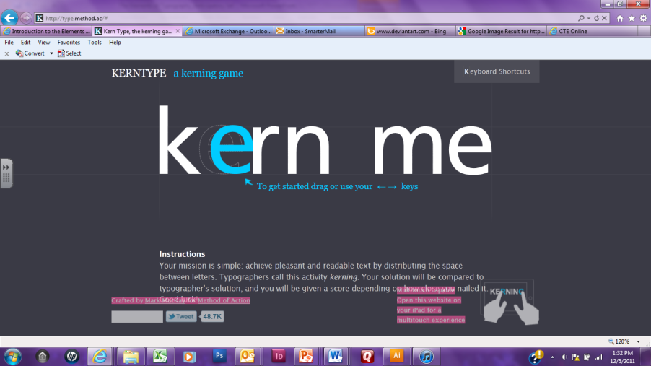
Try it Out
Go to:
http://type.method.ac/# and see how accurate you are at kerning.
Notes:
Have students go to this website and try their hand at kerning or you can go to the website and demonstrate kerning.

Slide 10
Alignment and Leading
Alignment
Tracking
Alignment-the way type is arranged on the page
Aligned Left, Jagged Right
Mrs. Rivard is the best teacher ever! She loves to teach computer graphics. Computer graphics is the best class ever.
Aligned Right, Jagged Left
Mrs. Rivard is the best teacher ever! She loves to teach computer graphics. Computer graphics is the best class ever.
Aligned Center
Mrs. Rivard is the best teacher ever! She loves to teach computer graphics. Computer graphics is the best class ever.
Justified – even on both sides
Mrs. Rivard is the best teacher ever! She loves to teach computer graphics. Computer graphics is the best class ever.
Leading – the space between lines.
Leading is the space between lines. Leading in the space between lines. Leading is the space between lines.
Leading is the space between lines. Leading in the space between lines. Leading is the space between lines.
Notes:
Describe ways to align type and what leading is.
CFU:
What are the different ways to align type?
What alignment type do you see the most in print?
What is leading?

Slide 11
Independent Activity:
Line Length is the length of the line of type.
If you use a larger font the line length should be longer to accommodate the same number of words.
Line length controls readability.
The longer the line length the harder it is for the reader to find the beginning of the line.
Extremely short line lengths can be very disruptive for the reader to comprehend what they are reading because there eye is constantly going back and forth.
Notes:
Describe to students what line length is.
CFU:
What is line length?
How does line length affect readability?

Slide 12
Independent Practice
Each student will be given a word that expresses an emotion or idea. It will be your job to go on to Adobe Illustrator and use type style, kerning, leading, and tracking to show the meaning of the word.
For example:
Notes:
For independent practice have students pick a word that shows an emotion then give them 10-20 minutes to type the word in Adobe Illustrator and have them adjust kerning, leading, tracking and typestyle to represent the meaning of the word.

