Slide 1
Typography
Typogra
Typogra
Typography
Typography

Slide 2
Objectives
Students will describe what kerning, tracking and leading are.
Students will describe the different types of type relationships.
Students will manipulate the kerning, leading, tracking and type style of a word to show the meaning of the word.

Slide 3
Anticipatory Set
Designers use typography to communicate a client's message to an audience.
They explore the creative possibilities presented by words (typography). It is up to the designer not only to find or create appropriate letterforms but also to establish the best balance between them.

Slide 4
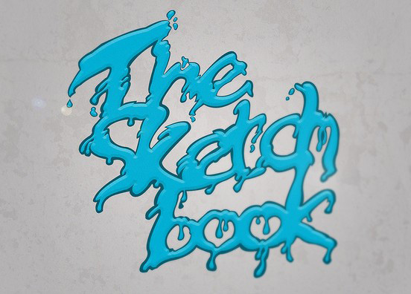

Slide 5
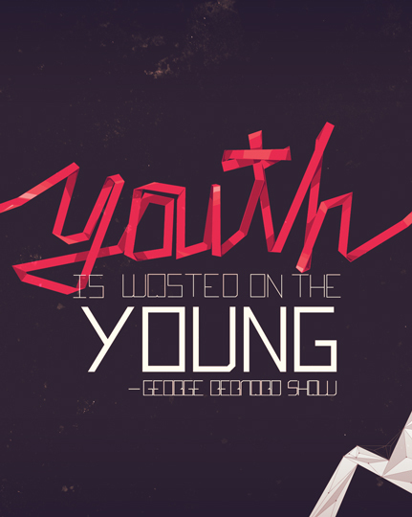

Slide 6
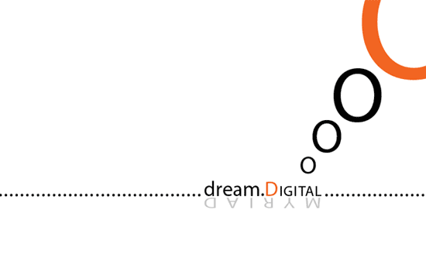

Slide 8
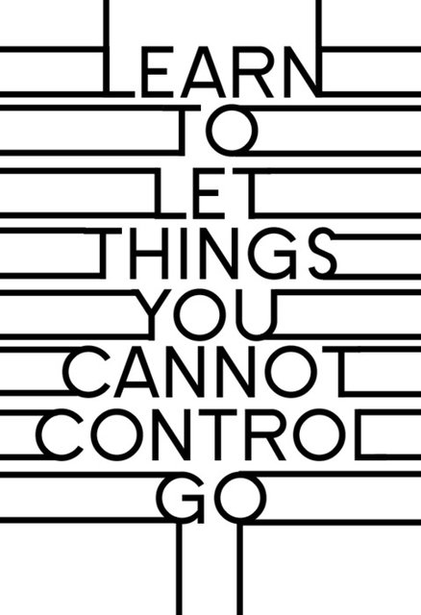

Slide 9
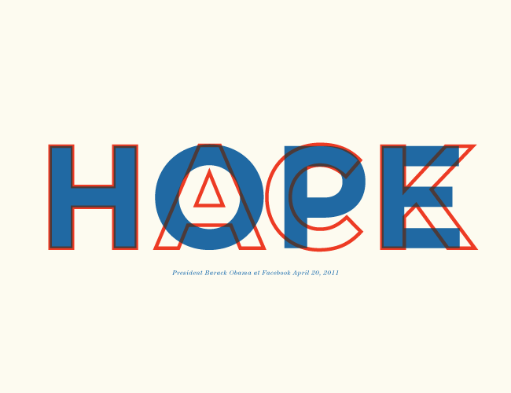

Slide 10
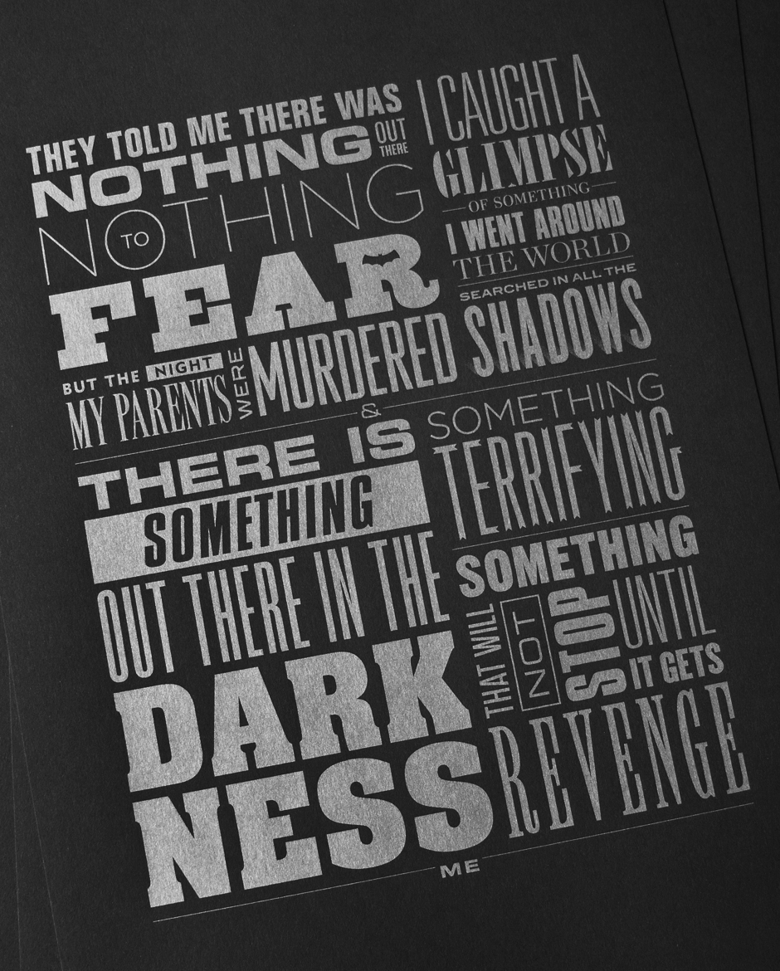

Slide 11
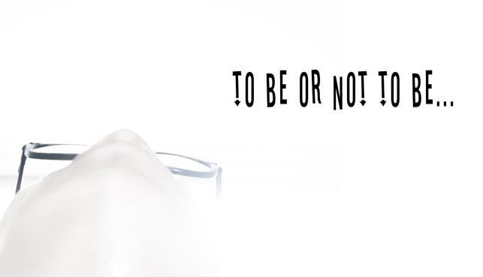

Slide 12
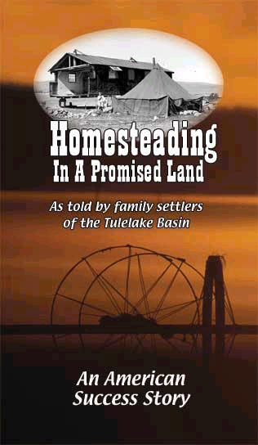

Slide 14
