Slide 1
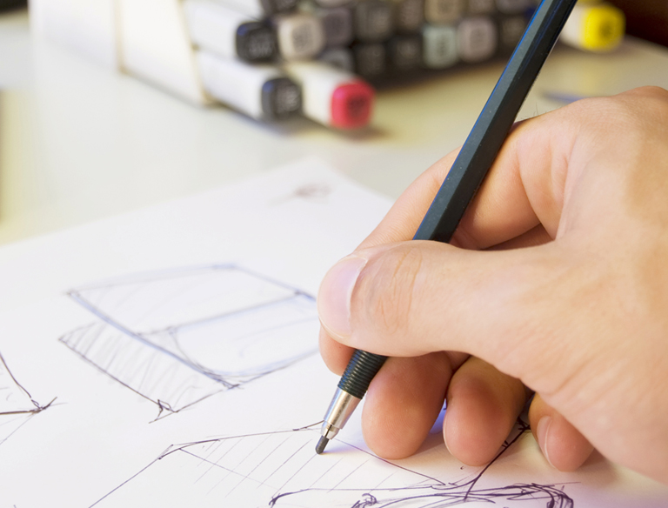
The Principles of Design in Layout

Slide 2
Objective: Students will describe and analyze the principles of design in digital art (contrast, balance, emphasis, repetition, unity, and variety).
Questions:
What will you be able to describe after this lesson?
What are you going analyze?
Objective
Students will describe and analyze the principles of design in digital art (contrast, balance, emphasis, repetition, unity, and variety).

Slide 3
Prior Knowledge
When you are reading a magazine or a newspaper, what catches your eye?
What are things that appeal to you as you look at a newspaper or magazine?
Objective: Students will describe and analyze the principles of design in digital art (contrast, balance, emphasis, repetition, unity, and variety).

Slide 4
Importance
It is important that you understand the basics of design, so that we have well designed documents.
Learning how to create designs that have impact is important to the success of any design project you are working on.
Also, understanding how to create designs is an important career skill in the graphic design field.
Objective: Students will describe and analyze the principles of design in digital art (contrast, balance, emphasis, repetition, unity, and variety).
Questions:
Explain why it is important that you understand the basics of design?
Where could you use the skills you learn in this class?

Slide 5
The Principles of Design The Principles of Design involve the way in which the elements of art are arranged in a piece of artwork. Artists use these principles to organize their work to create different effects.
Balance
Contrast
Emphasis,
Dominance, &
Subordination
Repetition
Rhythm
Movement
Unity &
Variety

Slide 6
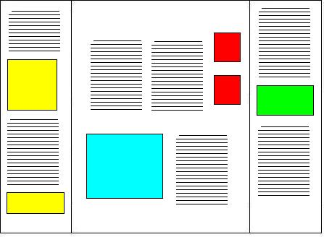
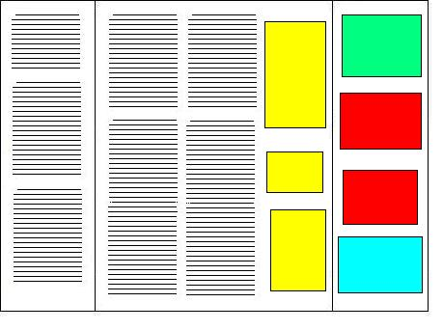
Balance
Objective: Students will describe and analyze the principles of design in digital art (contrast, balance, emphasis, repetition, unity, and variety).
Questions:
What is balance?
The way in which the elements in visual arts are arranged to create a feeling of equilibrium in a work of art.
Balanced Layout
Unbalanced Layout

Slide 7
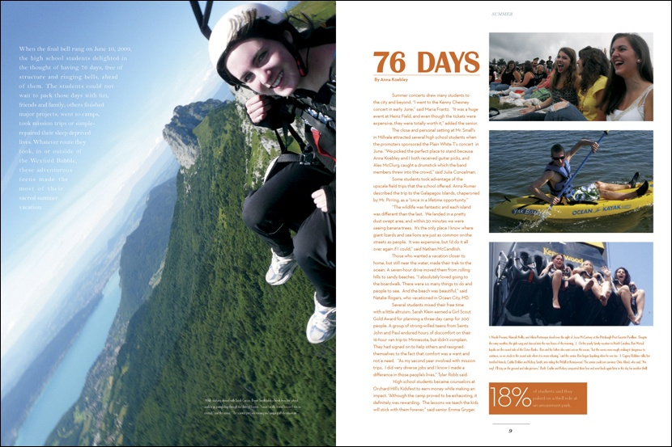
The large photo on the left is balanced by the smaller photos on the left.

Slide 8
The large photo on the right is balanced by the smaller photos and the larger type.

Slide 9
Contrast
Objective: Students will describe and analyze the principles of design in digital art (contrast, balance, emphasis, repetition, unity, and variety).
Questions:
What is contrast?
Give an example of one type of contrast.
Difference between two or more elements (e.g., value, color, texture) in a composition.
Line contrasts-thin/thick, different lengths, different directions, different types of lines
Shape/Form contrasts - free form/geometric, different types of shapes, different sizes of shapes
Texture contrasts - smooth/rough, different types of texture, different values of texture
Color contrasts-warm/cool colors, complimentary colors
Value contrasts - light/dark

Slide 10
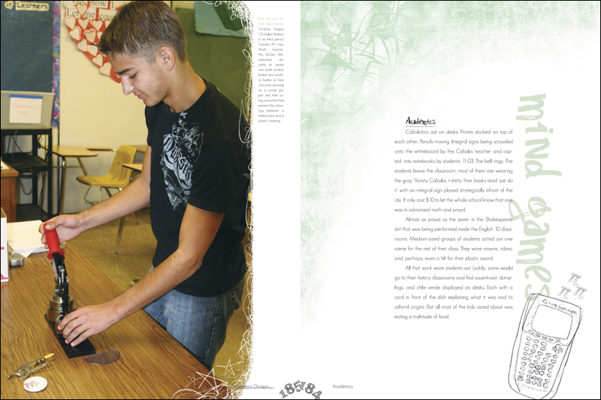
This layout has contrast in the values on the different pages.

Slide 11
This layout has contrast in the shape sizes.

Slide 12
Dominance and Subordination
Objective: Students will describe and analyze the principles of design in digital art (contrast, balance, emphasis, repetition, unity, and variety).
Questions:
What is dominance? Subordination?
Dominance. The importance of the emphasis of one aspect in relation to all other aspects of a design.
Subordination. Making an element appear to hold a secondary or lesser importance within a design or work of art.

Slide 13
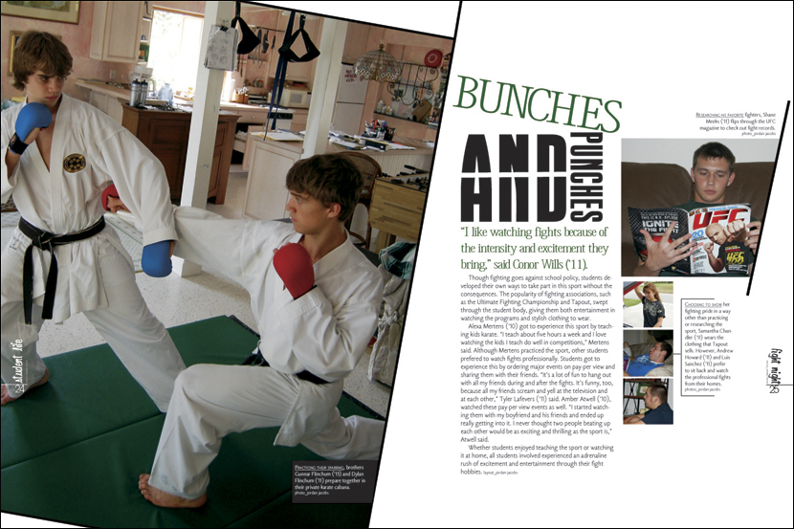
This layout has a dominant image supported by several smaller subordinate images on the right.

Slide 14
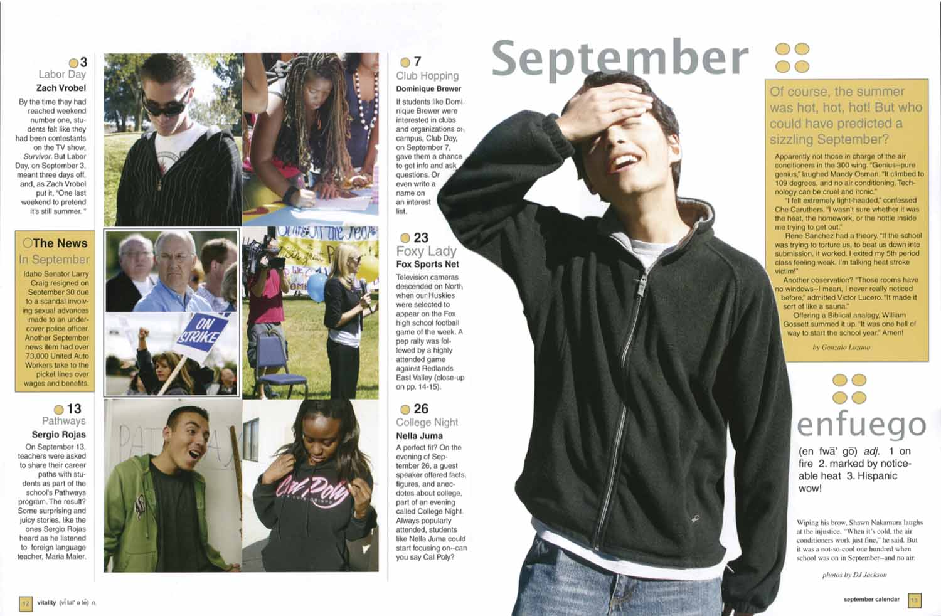
This layout has a dominant image supported by several smaller subordinate images on the left.

Slide 15
Emphasis
Objective: Students will describe and analyze the principles of design in digital art (contrast, balance, emphasis, repetition, unity, and variety).
Questions:
What is emphasis?
Special stress given to an element to make it stand out. Many times this achieved through the use of the other principles such as:
Emphasizing an element by making it dominant.
Emphasizing an element through contrast.

Slide 16
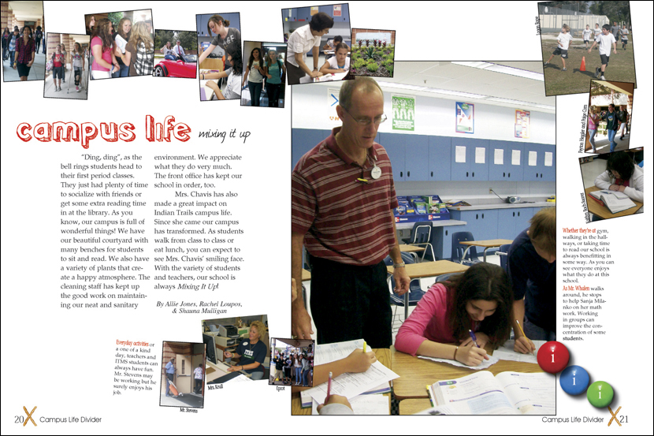
In this layout emphasis is given to the headline because of the color and the large photo because of the size.

Slide 17
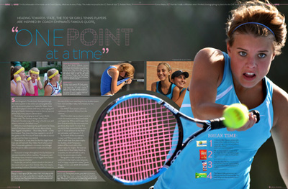
In this layout emphasis is give the girl because the photo is the largest and it is cut out.

Slide 18
Repetition, Movement, Rhythm
Objective: Students will describe and analyze the principles of design in digital art (contrast, balance, emphasis, repetition, unity, and variety).
Questions:
What is movement?
What is rhythm?
Movement. The principle of design dealing with the creation of action.
Rhythm. Intentional, regular repetition of lines of shapes to achieve a specific repetitious effect or pattern.

Slide 19
In this layout movement is created by the use of line leading to the main photo.

Slide 20
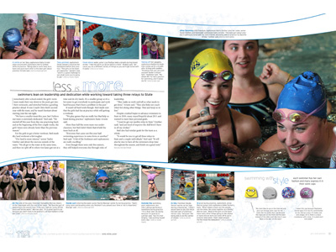
In this layout creates movement through lines and the repeated shapes of the photos.

Slide 21
Unity
Objective: Students will describe and analyze the principles of design in digital art (contrast, balance, emphasis, repetition, unity, and variety).
Questions:
What is unity?
Total visual effect in a composition achieved by the careful blending of the elements of art and the principles of design.

Slide 22
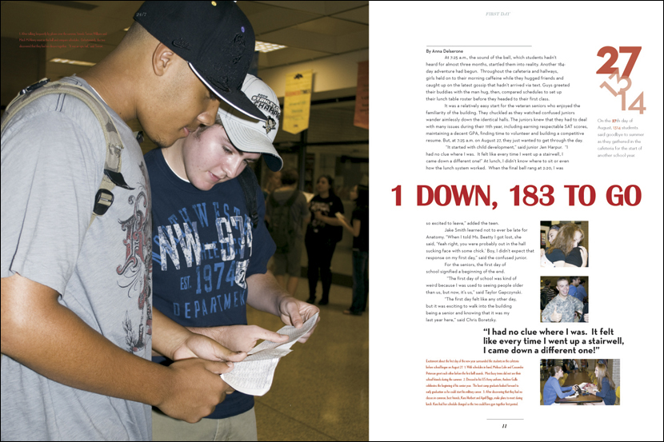
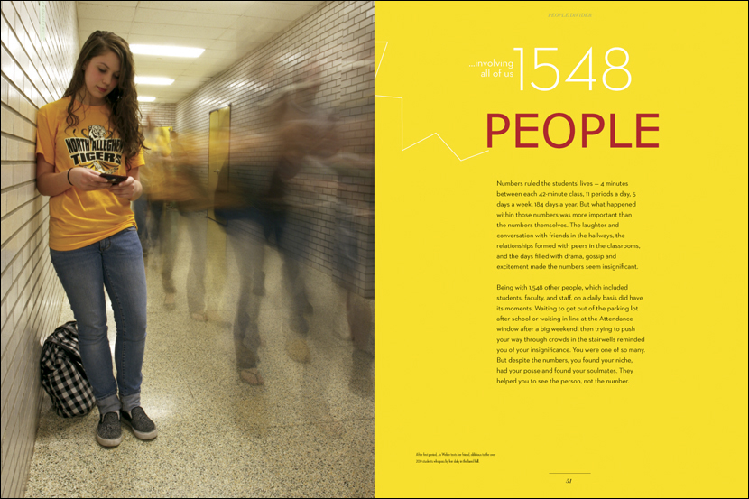
These layouts have unity created through repeated colors, shapes, and typography.

Slide 23
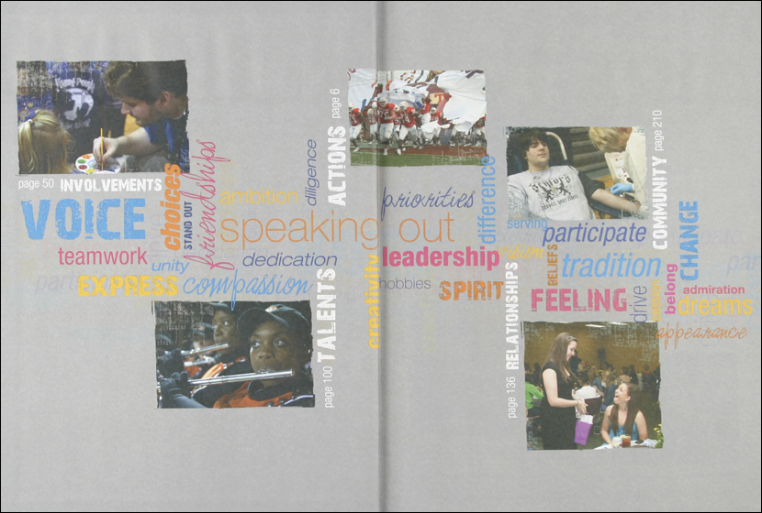
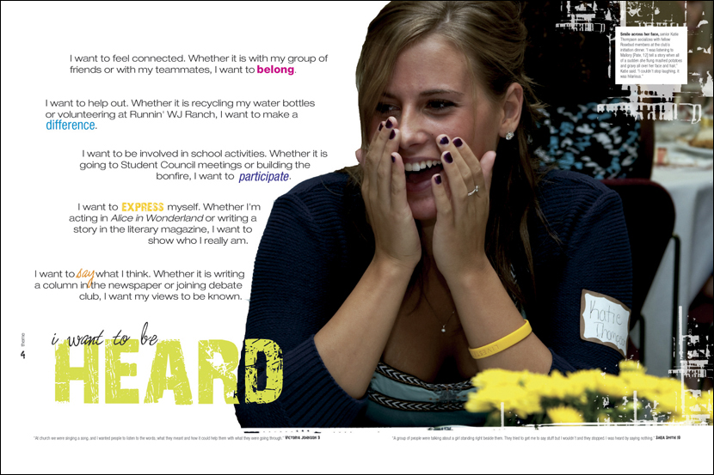
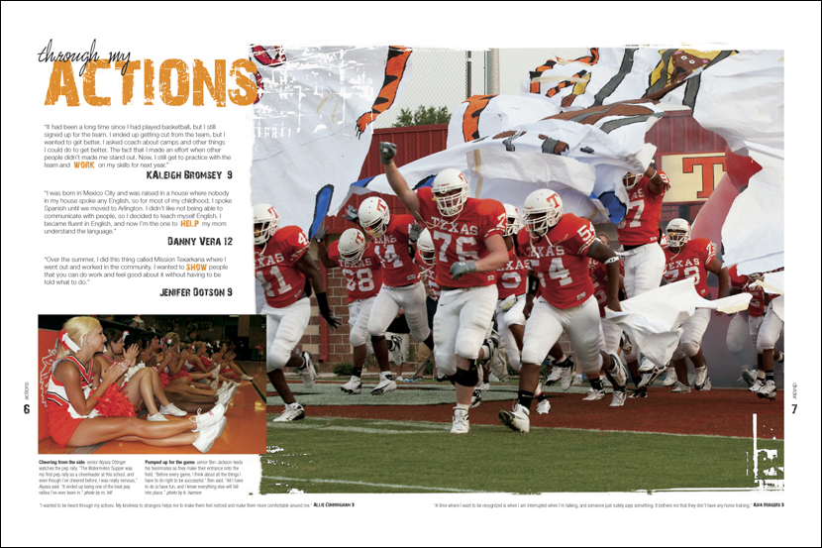
These layouts have unity created through repeated colors, shapes and typography.

